Slide 1
SAWTELL PUBLIC SCHOOL
NATIONAL
PARTNERSHIPS
2009-2011
NUMERACY

Slide 2
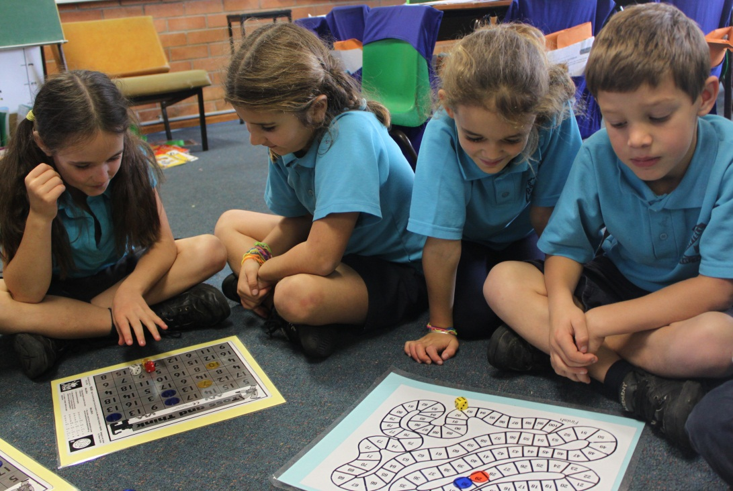
Why Mathematics?
Mathematics was chosen as our focus program after reviewing-
Smartdata from Naplan.
School data
Teacher preference for professional development.

Slide 3
Which Numeracy Programs? QUICKSMART
QuickSmart was an established support program within the school and was expanded from 12 students in 2009 to 36 students in 2010 and 2011.
Students chosen from years 4-6.

Slide 4
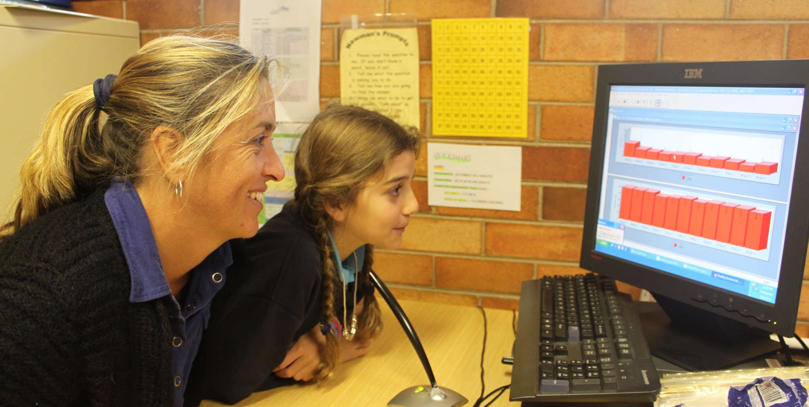
THE QUICKSMART SESSION

Slide 5
Taking Off With Numeracy (TOWN)
TOWN is a NSW DEC program.
This program has a whole class component as well as a component to support individual students.
The learning is based on the Place Value and Multiplication/Division Frameworks.
There is website support from DEC.
We initially went with both components but the individual support program was replaced by further commitment to QuickSmart.

Slide 6
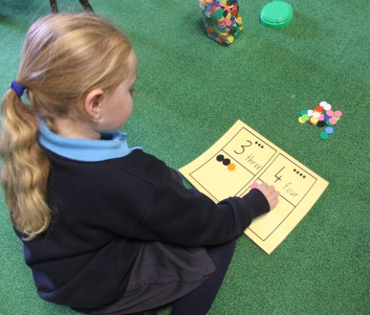
Count Me In Too (CMIT)
CMIT also had a history within the school and was expanded.
This allowed all classes,K-6 to be part of the National Partnership funding.
The CMIT EAS Framework sequentially links to the TOWN Place Value Frameworks.
In each class students were grouped according to individual progress on frameworks.
Resources were purchased to support group work.

Slide 7
Newman’s Problem Solving
The Newman’s Problem Solving approach was standardised across all grades K-6 through teacher collaboration.
A poster was designed, commercially printed and placed in every classroom.
This gave all students a common approach to solving written mathematical problems.

Slide 8
To solve a problem…
This
poster
in every
room.

Slide 9
The Leadership Program
The Leadership Program is a suite of modules that support teacher professional learning in best teaching practice.
These are presented within the school
eg Student Self Assessment

Slide 10
My addition and subtraction problem solving skills(EAS)
I need counters or fingers to add and subtract numbers up to ten.
I don’t need counters or fingers to add and subtract, I can see them in my mind, I count from 1
I can count on from the biggest number when I to 10. | I can count back from the biggest number to subtract from 10
I know how to use: doubles to 12 to add and subtract. | I know how to use my doubles to 12 to halve. | I know how to use: near doubles | I know how to use: combinations up to 10 | I know how to: bridge to 10 using my number combinations of 10 | I know how to use: combinations up to 10 to solve subtraction problems
2+2= 4+4= | Double 2 is 4 so half of 4 is 2. | 2+3 = 2+2+1 7+9 = 7+7+2 | 6+4=10 3+4=7 | 6+5 = 6+4+1 5+7 = 5+5+2 | 8+2=10 so 10-2=8 6+3=9 so 9-6=3

Slide 11
Place Value Check List
Place Value 2
I can round 2 digit numbers to the nearest 10 | I can partition 2 digit numbers into 10s and units. | I can use the split method to add 2 digit plus 2 digit numbers. | I can use the split method to subtract 2 digit from 2 digit numbers. | I can use the jump method to add two 2 digit numbers. | I can use the jump method to subtract two 2 digit numbers. | I can use the compensation method to add two 2 digit numbers | I can use the compensation method to subtract two 2 digit numbers | I can combine and partition numbers up to 100.
34 rounds to 30 75 rounds to 80 | 76 = 70 + 6 | 32 + 24 = 56 30 + 20 = 50 2 + 4 = 6 50 + 6 = 56 | 56 – 24 = 32 50 – 20 = 30 6 – 4 = 2 30 + 2 = 32 | 32 + 24 = 56 | 56 – 24 = 32 | 38 + 24 = 62 38 + 2 = 40 40 + 22 = 62 | 62 – 29 = 33 62 – 30 = 32 32 + 1 = 33 | 76 = 16 + 60 76 = 70 + 6 76 = 50 + 26 76 = 39 + 37

Slide 12
Place Value Check List
Place Value 5
I can order any numbers of any value to 3 decimal places | I can add and subtract decimal numbers with a different number of decimal places. | I can explain what happens to a number when it is multiplied or divided by a 10, 100 or 1000 | I can state the place value and the value of any digit in any number. | I understand the importance of the zero as a place value marker in a decimal number.
0.23, 0.002, 2.033, 0.226, 5.60. | 56.43+3.045+ 4.7+0.564= | 25.6X100=2560 | 3785921.4205 The 8 has a place value of ten thousand and a value of 80000 | 3785921.4205 The zero represents the thousandths column.

Slide 13
GIFTED and TALENTED PROGRAM
Targeted students from Stage One to Stage Three were presented with higher level learning opportunities in Mathematics.
Current staff were given leadership opportunities and delivered the extension programs.
Stage Three were also given GATS opportunities at Toormina HS.
Maths Master Competition from year 1-6.

Slide 14
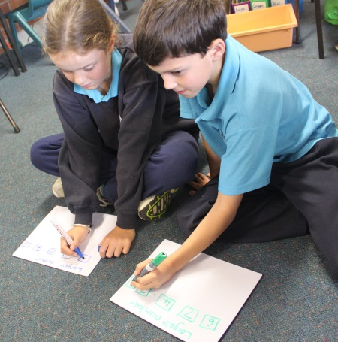
LESSON STUDY
Teachers plan a maths lesson with a buddy.
Both observe each other teaching the lesson.
Discuss what was successful and what would make the lesson better. (The discussion can take place after both have taught the lesson or after one person teaches and then the other reteaches the lesson with the changes.

Slide 15
TECHNOLOGY
Purchase of computers for classrooms.
Purchase of maths programs for students . These are used to support group work.

Slide 16
SUSTAINABLE PROGRAMS?
Timeframe | Program | Cost | Program Summary/Issues
Aug 2009- June 2011 | TOWN | $$$$$ | 1) Principal and team leader training. 2) Teacher T and D on Place Value and Multiplication/Division frameworks. 3) Teachers’ aides in classrooms to support group work. 4) Planning/reflecting with buddy teacher. 5) Student assessment. 6) Team Leader responsibilities ( VCs, T and D)
Aug 2009- June 2011 | CMIT | $$$$$ | 1) Teacher T and D on CMIT frameworks. 2) Teachers’ aides in classrooms to support group work. 3) Student assessment.

Slide 17
Aug 2009- June 2011 | Resources | $$$$ | 1) Purchase of resources to support maths group teaching. (Master set) 2) Creation/ Organisation of digital resources for teachers on staff drive
Jan 2010- June 2011 | QUICKSMART | $$$$$ | 1) Training of tutors 2) Purchase of program. 3) 2 computers and space within school 3) 36 students for 30 week program in 2010 and 36 students for 20week program in 2011.
Aug 2010 | Technology | $$$$$ | 1) Purchase of 2 computers for each classroom. 2) Purchase of software to support classroom computers and IWBs.

Slide 18
May 2010- Sept 2010 | Gifted and Talented Maths program | $$ | 1) Identified teachers within school deliver higher level maths activities to identified Stage 1, Stage 2 and Stage 3 students. 2hrs per week for 5 weeks
July 2010- June 2011 | Leadership | $ | 1) Leadership Team present modules as part of T and D

Slide 19
July/Aug 2010 | Student Feedback Sheets | $$ | 1) Collaboration with Sth Grafton P.S. to develop student feedback sheets to aid in student self assessment.
Sept 2010 | Lesson study | $$ | 1) Buddy teachers plan a lesson together with Maths consultant.. 2) Watch each other present the lesson . 3) Discuss lesson together. “What to keep ? What to change? Where to next?”

Slide 20
Jan 2010- sustainable | NEWMAN’S PROBLEM SOLVING | $ | 1) T and D on Newman’s approach for all staff. 2) Development of Problem Solving Steps Poster for all classrooms K-6.
Aug-Oct 2010 | Maths Language Book | $ | 1) Development of standardised language book. Maths terms to be used K-6 when talking about algorithms, place value etc.
Aug 2010-Aug 2011 | Maths Master | $ | 1) Similar to Spelling Bee but maths questions. 2) Expand to Bongil Bongil COS in 2011?

Slide 21
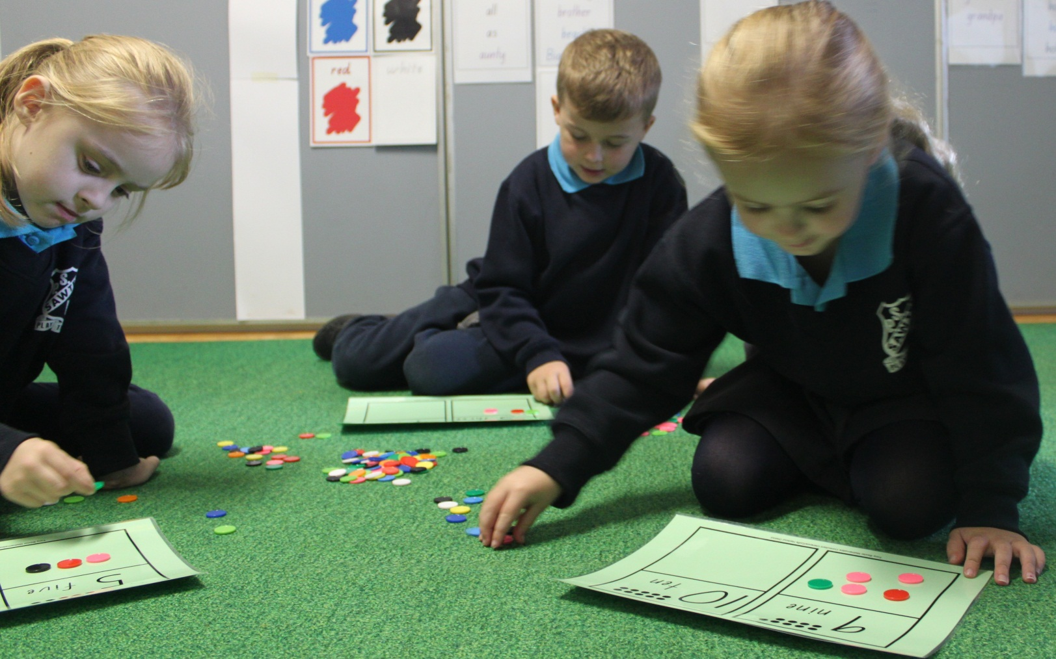
Improved numeracy outcomes for students.

