Slide 1


National Literacy and Numeracy Partnerships Forum
Brisbane, 11 / 11 / 11 .
Mayfield East Public School
Presented by: Alan Watt, Julie Low & Chris Wall

Slide 2

‘Accelerating Life-Long Learners…
a journey from
Anonymity to Lighthouse.’

Slide 3
This is Mayfield East PS
Mayfield East is on traditional Awabakal land, located in the centre of industrial Newcastle and in the Hunter / Central Coast Region and servicing a diverse
socio-economic community.
High mobility of school population.
High rate of student suspension.
High proportion of students in Bands 1&2 in NAPLAN data.
30% students from NESB or ATSI background.
Attendance is above Regional requirements, but not reflected in the school’s results.
Despite using ‘best practice’ and having more than adequate resources, many of our students were not achieving expected outcomes in literacy.
In classes across the grades teacher talk focussed on regulatory language to manage student behaviours rather than on the language of explicit teaching and learning.

Slide 4
Mayfield East PS our Choices.
At Mayfield East we decided to focus on the pedagogy to make the difference.
We choose Accelerated Literacy.
The greatest effect on student learning is then achieved through identifying and focusing on what teachers do.
‘...the most important factor affecting student learning is the teacher... The immediate and clear implication of this finding is that seemingly more can be done to improve education by improving the effectiveness of teachers than by any other single factor.’
Wright, Horn and Sanders (1997)

Slide 5

Destiny is not a matter of chance,
it is a matter of choice. Anon.

Slide 6
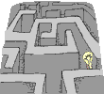
Things had to change ...
Definition of foolishness ...
..repeating the same behaviours
and expecting different results.

Slide 7
Why Accelerated Literacy?
Teaches ways of thinking for operating successfully within the literate discourse.
Uses high quality age appropriate text.
All students work on the same book - teaches syllabus outcomes appropriate for students’ age and stage .
Teaches how effective authors write – author’s language choices – what, how and why (intentionality, structure, literary devices, grammar).
Specific pedagogical sequence, but allows teachers their own effective strategies in skill based components.
Specific questioning technique – develops shared knowledge - low risk – high success
It is what teachers do before the students read that makes the difference.

Slide 8
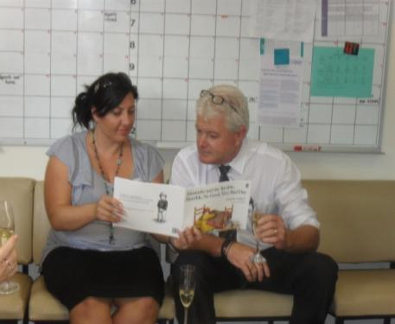
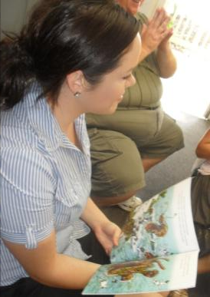
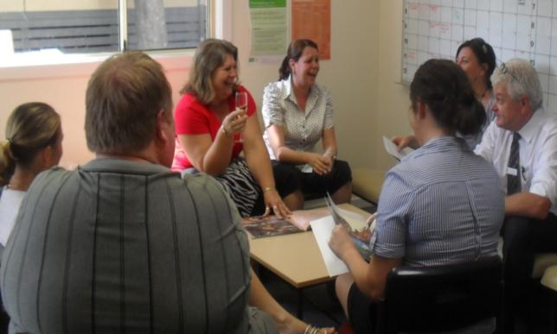
Accelerated Literacy
Hunter/Central Coast model
Staff training
In-school support
Parent workshops
Resourcing
School mentors

Slide 9
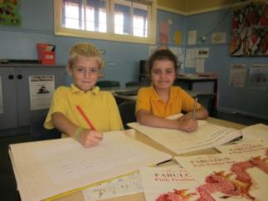

Accelerated Literacy
At Mayfield East we don’t teach AL we teach literacy as mandated by the DET English K-6 syllabus and supporting documents, using the pedagogy of Accelerated Literacy.
The teaching sequence firmly embedded in the pedagogy has provided teachers with the platform from which to explicitly teach the content of the syllabus.
Increased levels of professional dialogue
around teaching, learning and assessment.
Increased levels of student engagement.

Slide 10
teachers
classroom practice

Slide 11
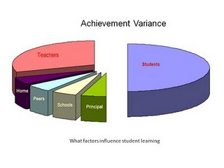
John Hattie
Quality of teaching
Teacher expectations
Teachers’ conception of teaching processes
Teachers openness and flexibility
Classroom climate
Clear articulation of criteria and expectation
Fostering effort
Engagement of students
Teachers Make a difference

Slide 12
classroom practice
student expectations
accountability & pedagogical change
community expectations
teachers
collect, collate, analyse & use data
DET and syllabus requirements
?
?
motivation
resourcing
?
school planning, structures and organisation
strategies & vision

Slide 13
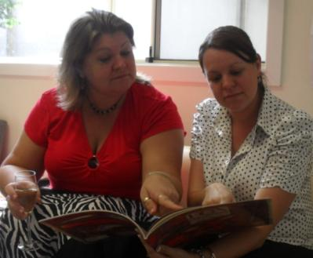
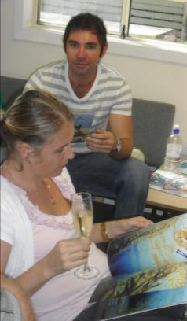
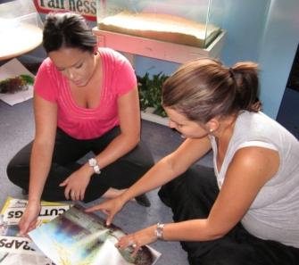
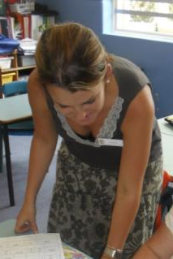
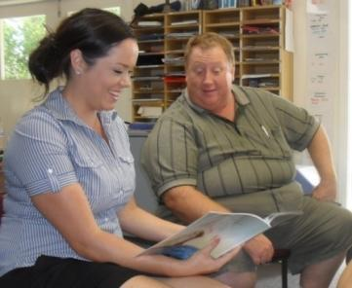
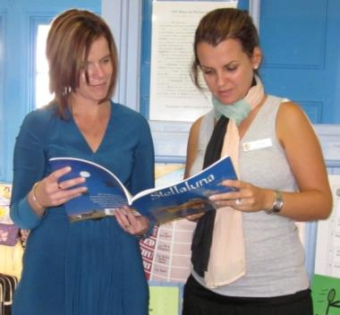
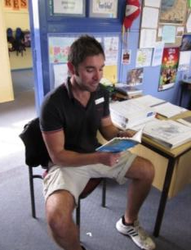
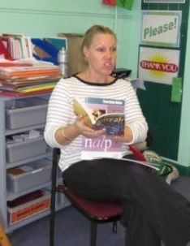
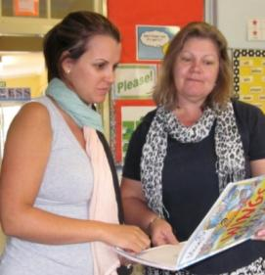
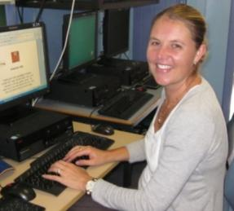
Acknowledged the issues & accepted the challenge ...
Professional learning
(AL pedagogy) implemented ...
Given direction, goals and encouraged to become risk-takers
In-class support from school leaders and facilitator

Slide 14
Mayfield East PS our Solution.
improved student outcomes
community
Actively involved
Shared values & vision
teachers
Shared vision
Common goal
pedagogy
Implemented and fully supported

Slide 15
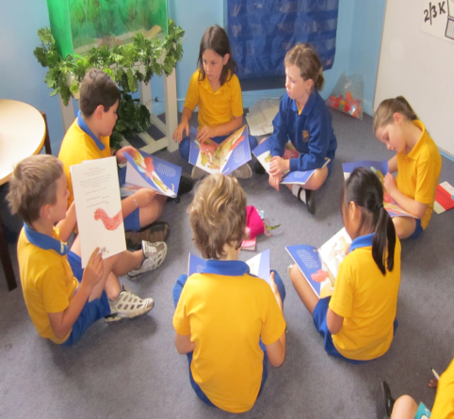
teachers
highly motivated
fully supported
students
engaged
challenged
community
informed
included
expectations clearly articulated
Happy, productive classrooms
Relational trust

Slide 16
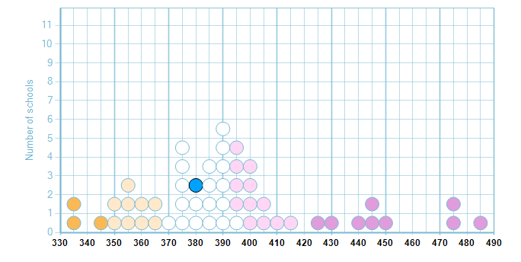
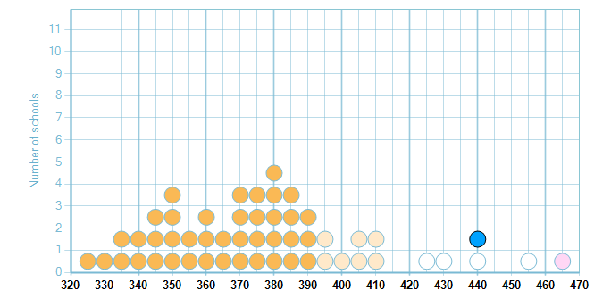
Year 3 Reading 2009 - 2010

Slide 17
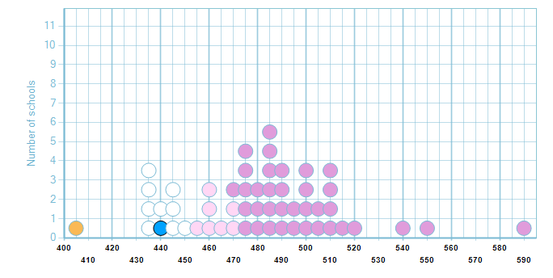
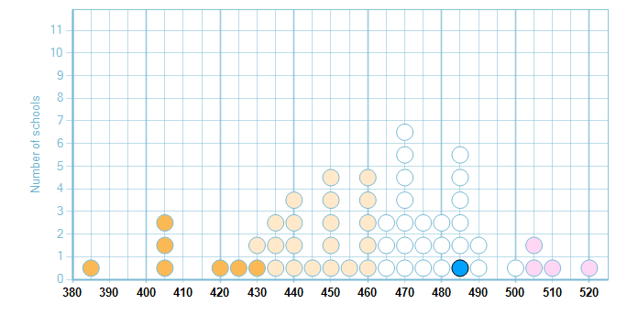
Year 5 Reading 2009 -2010

Slide 18
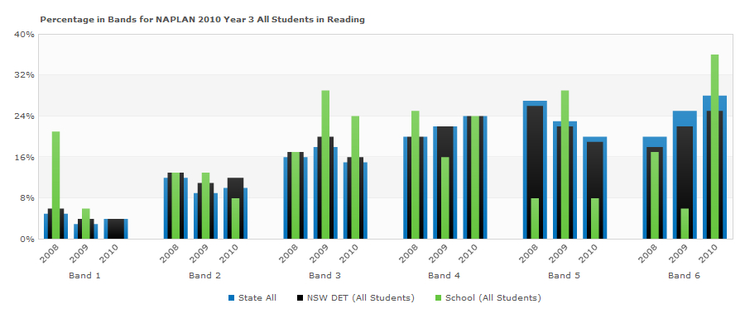
MEPS Year 3 Reading

Slide 19
MEPS
BOYS
rocketed!

Slide 20
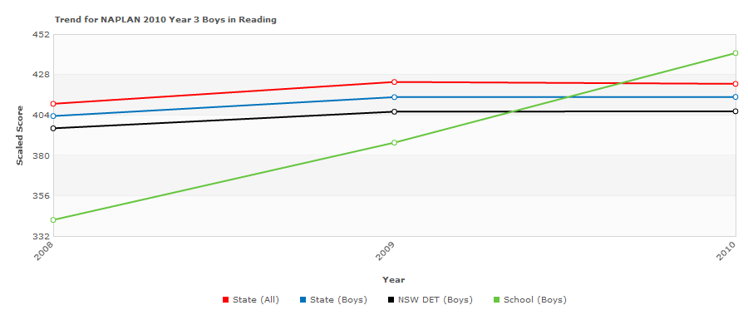
Celebrating Boys’ Success - Reading

Slide 21
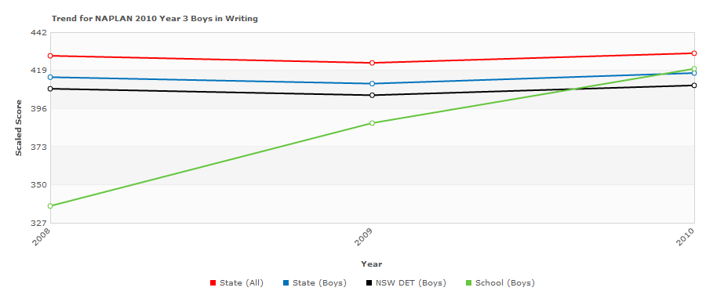
Celebrating Boys’ Success - Writing

Slide 22
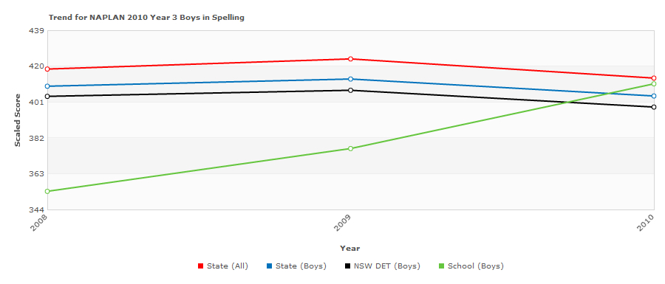
Celebrating Boys’ Success - Spelling

Slide 23
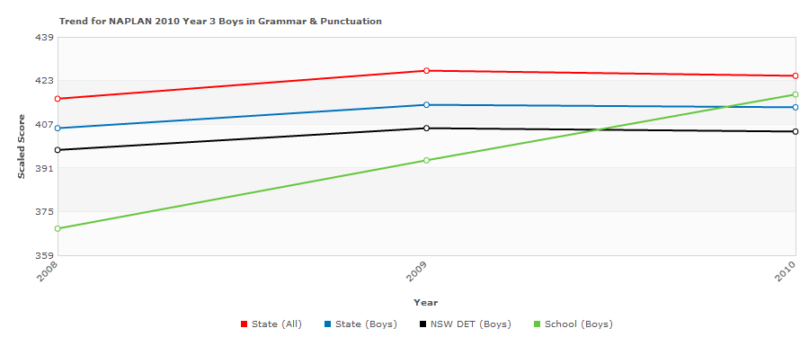
Celebrating Boys’ Success – Punctuation & Grammar

Slide 24
Our journey ...
. . . to sustainability.

Slide 25


The road
to success
is always

Slide 26
MEPS Planning Model
consult
National Partnerships L&N
PSP
BER and NSP
Stephanie Alexander Kitchen Garden Project
Corporate support of educational programs
Accelerated Literacy
MultiLit
Parent workshops
STLA / Reading Recovery allocation
Classroom leaders
Technology
TPL
collaborate
consolidate
communicate

Slide 27
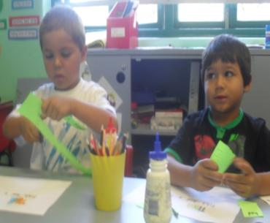
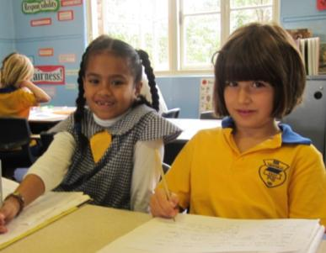
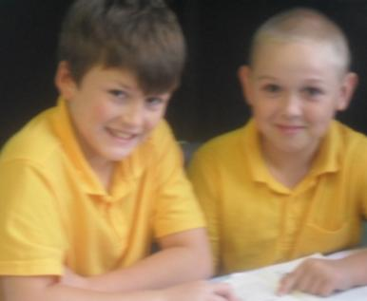
We care
We craft
We’re
consistent

Slide 28







Corporate Support for Educational Programs
Port Waratah Coal Services
Pacific National
Franklins
Incitec Pivot
CBA – Mayfield branch
Maitland Mutual Building Society
Cargill
Chuck Duck Good Life Truck Pty Ltd

Slide 29

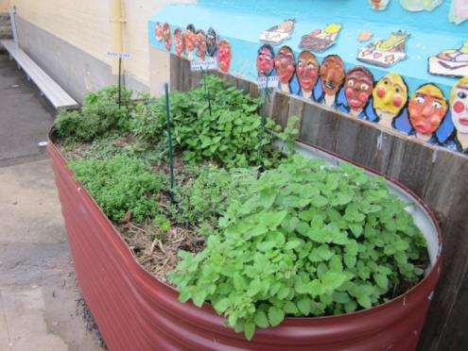
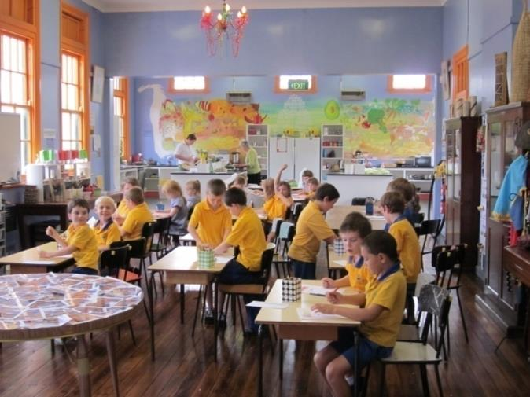
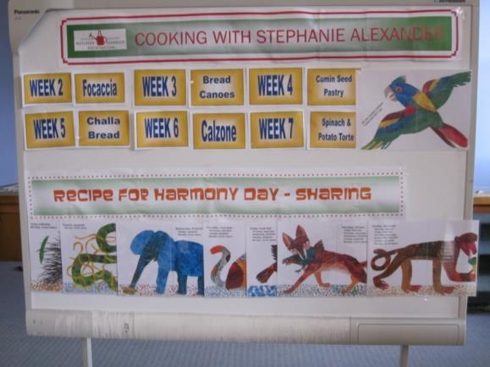
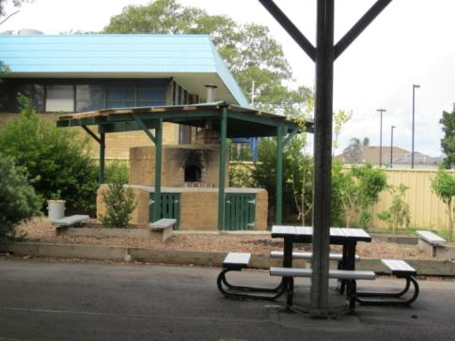
Stephanie Alexander
Kitchen Garden Project

Slide 30
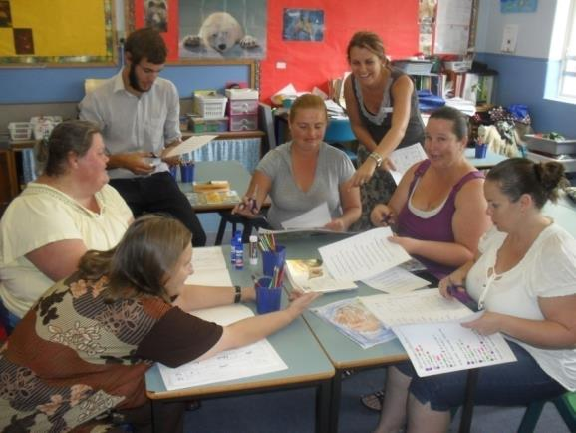
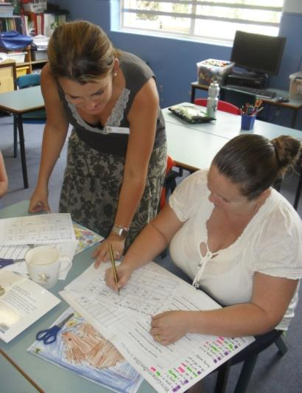
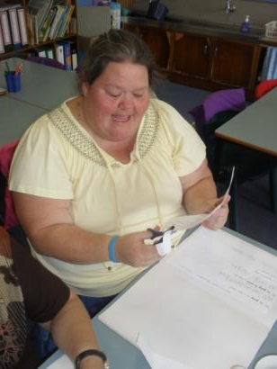
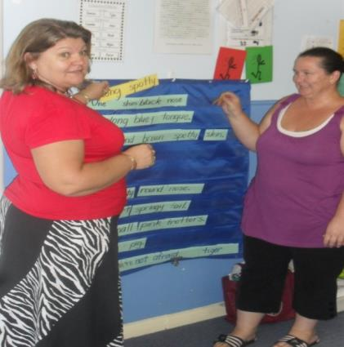
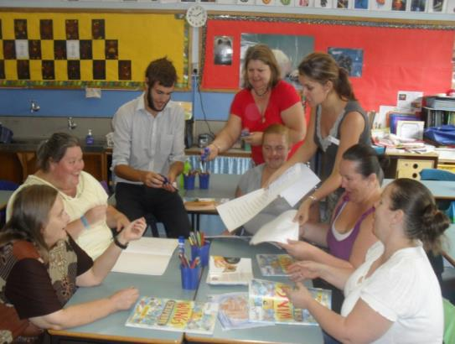
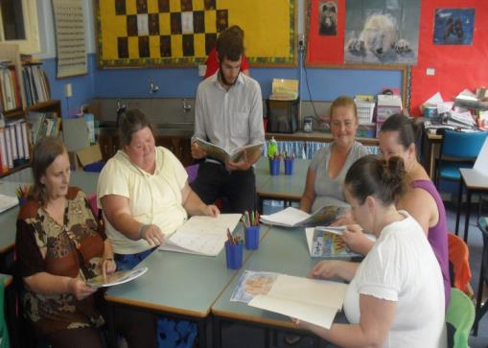
Parent Workshops

Slide 31

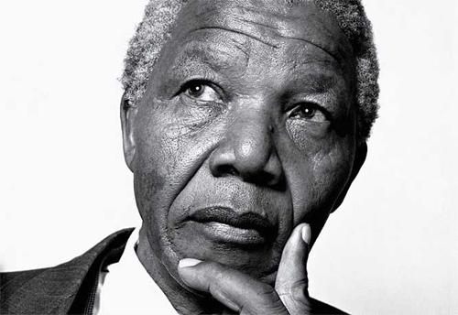
Education is the most powerful weapon you can use to change the world.

Slide 32

What the kids said ...
Reading in AL lets my mind imagine what is happening.
Now I can write like an author.
AL enables me to express my inner most feelings, in ways I can’t believe.
AL lets me explore what the author says and why they do it.
AL helps my Maths because I can read the questions better.
Reading has always been an important part of my life, but now I enjoy the quality texts we use and the rich vocabulary.
Transformations are the BEST!
This is the school of AWESOMENESS…
It’s my favourite part of the day.
Girls don’t hog all the answers anymore.
I am able to answer my teacher’s questions now.
I don’t feel dumb now.
I love the texts we read!

