Slide 1

Fairfield High School NSW
- Our National Partnership Journey -

Slide 2

Our values…

Slide 3
NATIONAL PARTNERSHIP TIMELINE
- First steps…
2010 - School audit to determine priority areas
2011 - National Partnerships commences at Fairfield High School
Team structure put in place

Slide 4
The National Partnerships team
The Team consists of multi disciplinary executive teachers who are responsible for addressing the six reforms under the direction of the Principal in order to improve student learning outcomes, including:
Principal, Mr Robert Mullas
Deputy Principal National Partnership
Deputy Principal
Head Teacher National Partnerships
Head Teacher Student Support
Head Teacher Student Engagement
Head Teacher Teaching and Learning
Head Teacher Technology
Head Teacher Secondary Studies
Community Liaison Officers
HSC Work Skills Coordinators

Slide 5
NATIONAL PARTNERSHIP TIMELINE CONTINUES...
Year 11 Work Skills HSC begins
Training and development opportunities, including staff conferences
Tertiary partnerships established
Primary partnerships with Fairfield Public School

Slide 6
NATIONAL PARTNERSHIP TIMELINE CONTINUES...
Senior Study Space
2012 Work Skills HSC in Year 11 and Year 12
Parent cafe growing to include community garden and kitchen
Focus on Reading training commences
Year 7 teaming teachers established with support in the classroom

Slide 7
NATIONAL PARTNERSHIP TIMELINE CONTINUES..
Staff conference held at University of Sydney​
Tertiary partnerships growing with launch of Bridges to Higher Education
Widening Participation Partnerships established with the Tertiary Sector:
  University of Sydney’s Compass program & Future Directions Network
  U@UNSW, UWS Fast Forward
  U@UTS & University of Newcastle “Live it Up” program
2012 Primary partnerships strengthened through observation of Year 7 classes​

Slide 8
NATIONAL PARTNERSHIP TIMELINE CONTINUES..
2013 Work Skills HSC continuing after successful evaluation
Parent Cafe growing to include more community cultures
Focus on Reading training continues into Phase 2 and facilitator training
Employment of a HT Secondary Studies

Slide 9
Building capacity & sustainability through professional learning
- Key Concepts -
Results - focused teamwork
Data-focused planning for school improvement
Beliefs and values about teaching and learning
Strategic professional learning
Teachers as leaders
Sustained effectiveness
Sustainability
Teacher Quality

Slide 10
Building capacity & sustainability through professional learning
All executive and aspiring leaders trained in 2012 in Team Leadership for School Improvement (TLSI)
The Team Leadership for School Improvement K – 12 program and The NSW DEC Analytical framework for effective leadership and school improvement in literacy and numeracy
are based on the current research about ‘what works in schools’ to ensure that the educational programs are given the best possible chance of succeeding
supports school leaders to develop a whole school culture of high performance in literacy and numeracy
builds the capacity of principals and other members of school leadership teams to drive continuous improvement, through identification and implementation of proven literacy and numeracy practices and the use of student and school performance data
provides a customised school plan based on the current school context and the next steps – remembering that no two schools are the same.

Slide 11
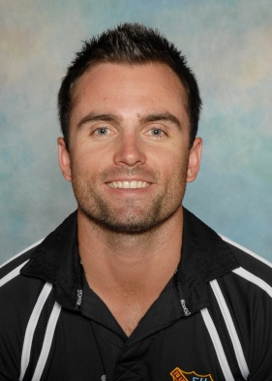
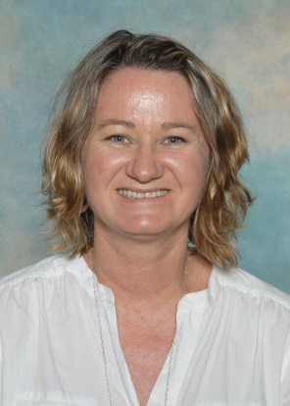
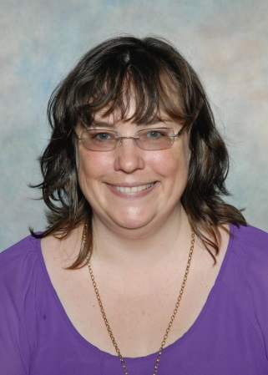
Creating new leadership opportunities across the school
Creating a National Partnerships Team has allowed for a number of aspiring teachers across the school to access new leadership opportunities therefore strengthening leadership capacity at Fairfield High School
          Relieving HT Welfare
          Relieving HT Maths
          Relieving HT Science
          Relieving HT CAPPA

Slide 12
Where to next?
Strategies incorporated into the current 3 year school plan to sustain current programs include:
Strategies and systematic Teacher Professional learning to address ongoing teacher learning needs in the 21st Century
All teachers to be trained in Focus Reading
Building ICT skills amongst all staff through TPL & sharing ICT teaching practice

Slide 13
…and beyond 2014?
In 2013 staff commenced sharing best teaching practice for school improvement through teacher peer observations where every teacher participates in strategically planned peer observations 3 times per year
New coordinators for all tertiary programs
Maintaining key executive roles post 2014

Slide 14
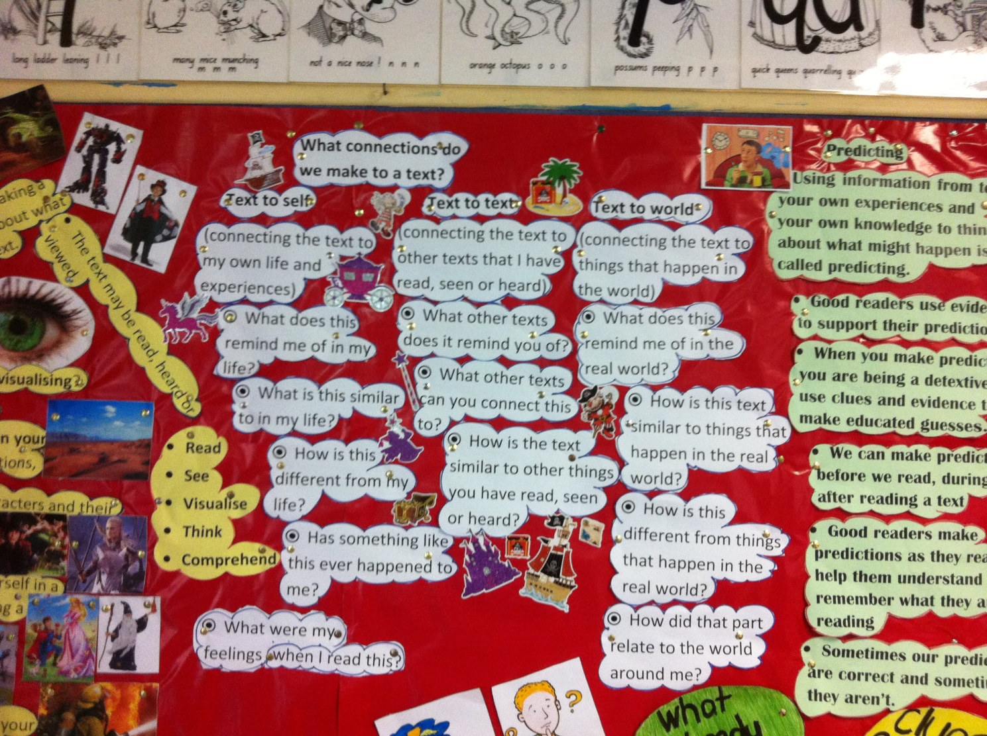
Focus on Reading
Walls that Teach

Slide 15
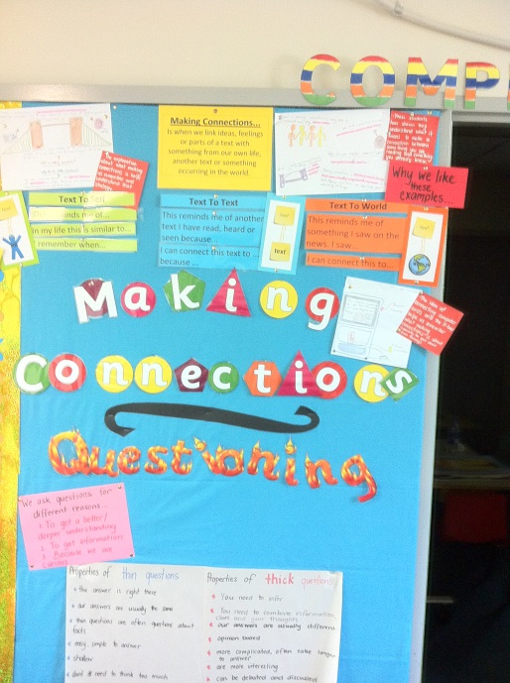
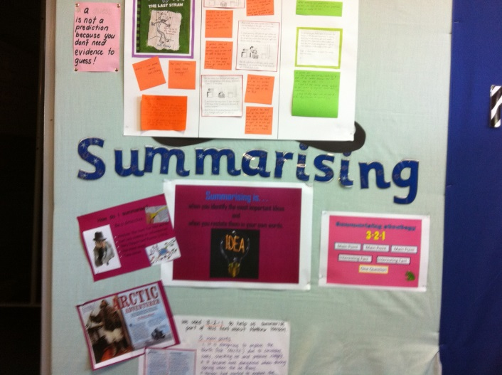
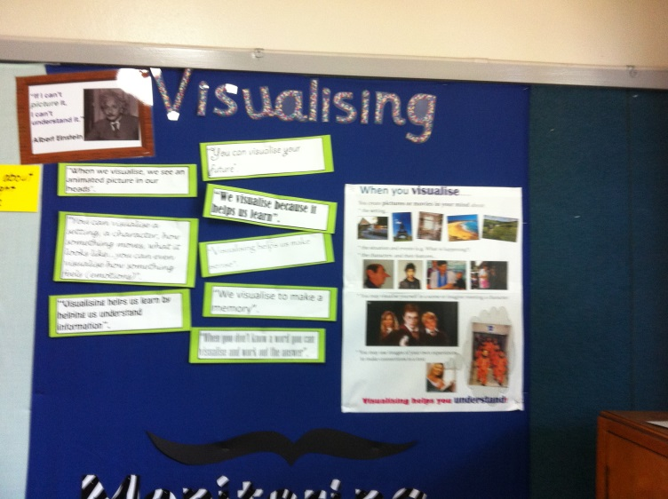
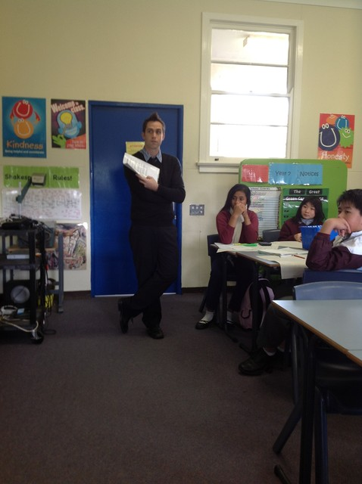
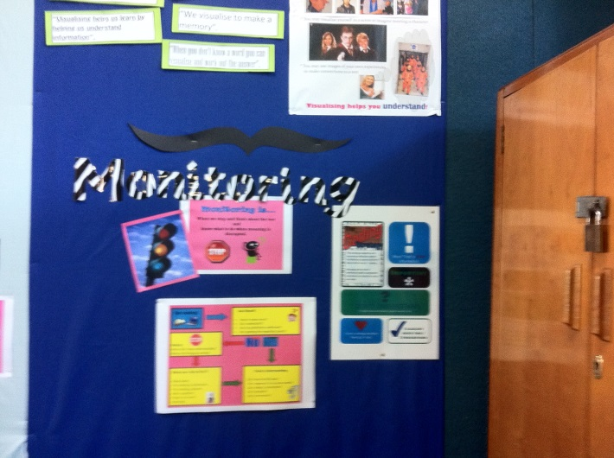
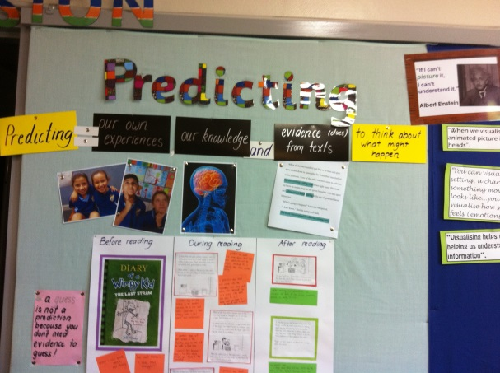
Focus on Reading
Super six comprehension strategies

